Slide 1
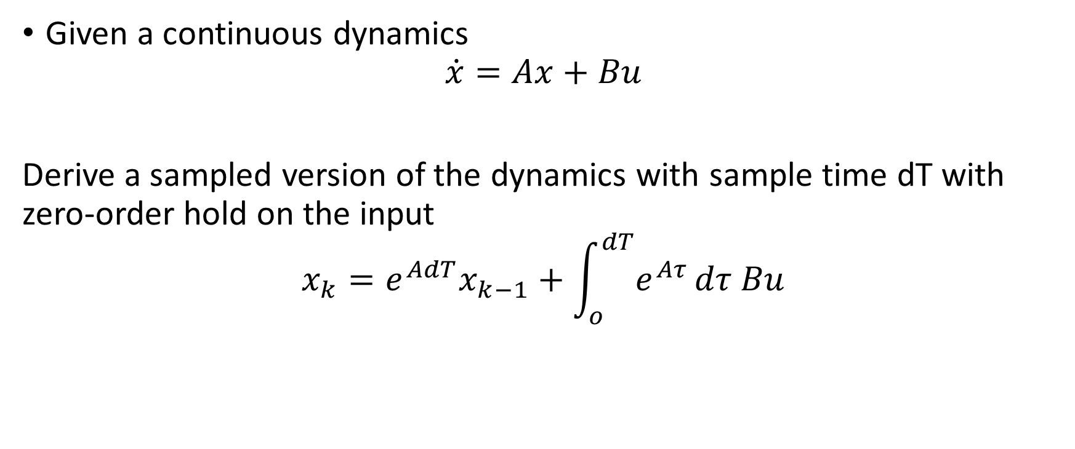
Discrete Version of State Equations
Given a continuous dynamics
$$\dot{x}=Ax+Bu$$
Derive a sampled version of the dynamics with sample time dT with zero-order hold on the input
$$x_{k}=e^{AdT}x_{k−1}+\int_{o}^{dT}{e^{Aτ}}dτ Bu$$

Slide 2
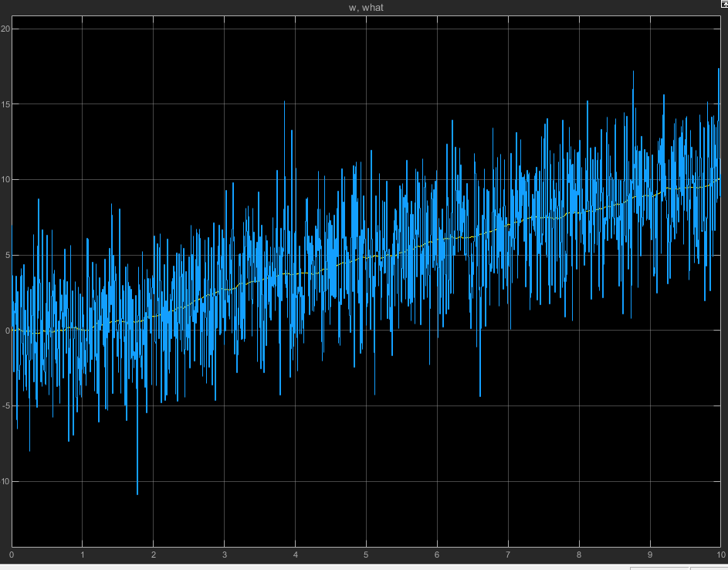
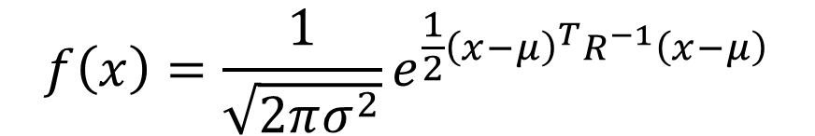
Statistical Properties of noise
$$f\left(x\right)=\frac{1}{\sqrt{2πσ^{2}}}e^{\frac{1}{2}{\left(x−μ\right)}^{T}R^{−1}\left(x−μ\right)}$$
$$x \sim N(μ,R)$$

Slide 3
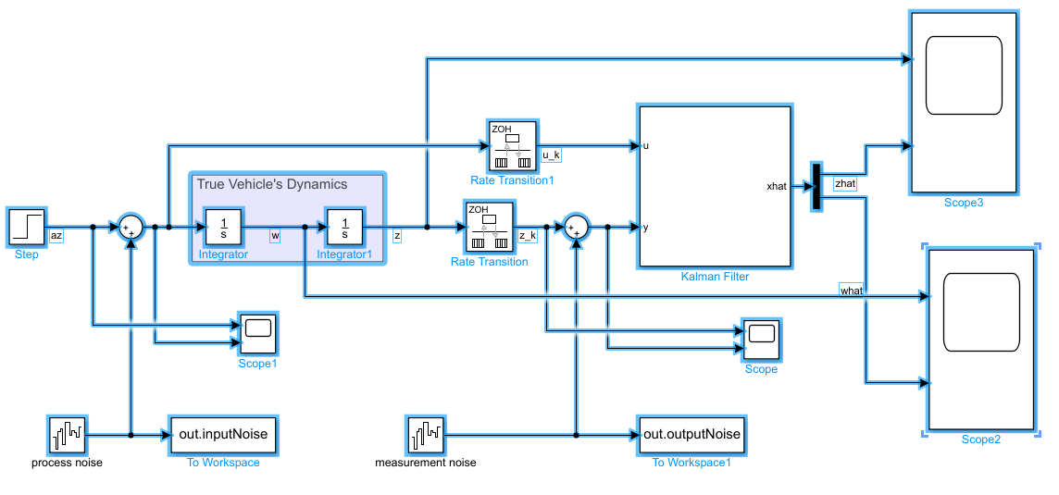
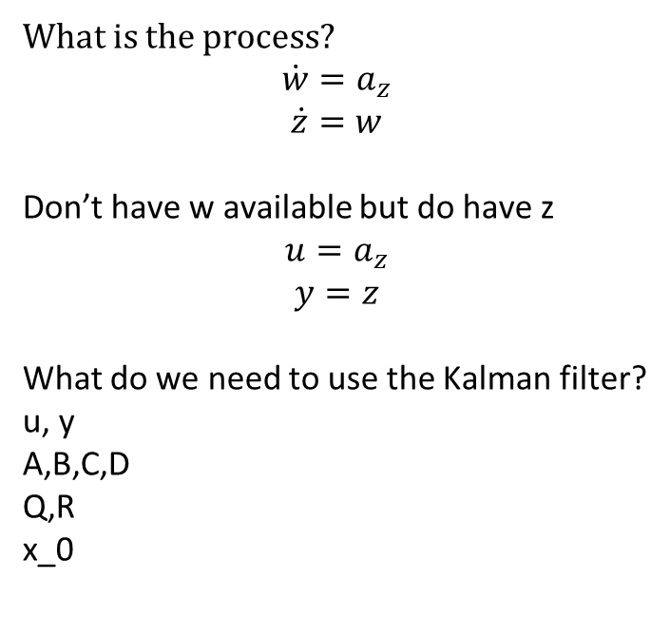
Constructing the Discrete Kalman Filter
What is the process?
$$\dot{w}=a_{z}$$
$$\dot{z}=w$$
Don’t have w available but do have z
$$u=a_{z}$$
$$y=z$$
What do we need to use the Kalman filter?
u, y
A,B,C,D
Q,R
x_0

Slide 4
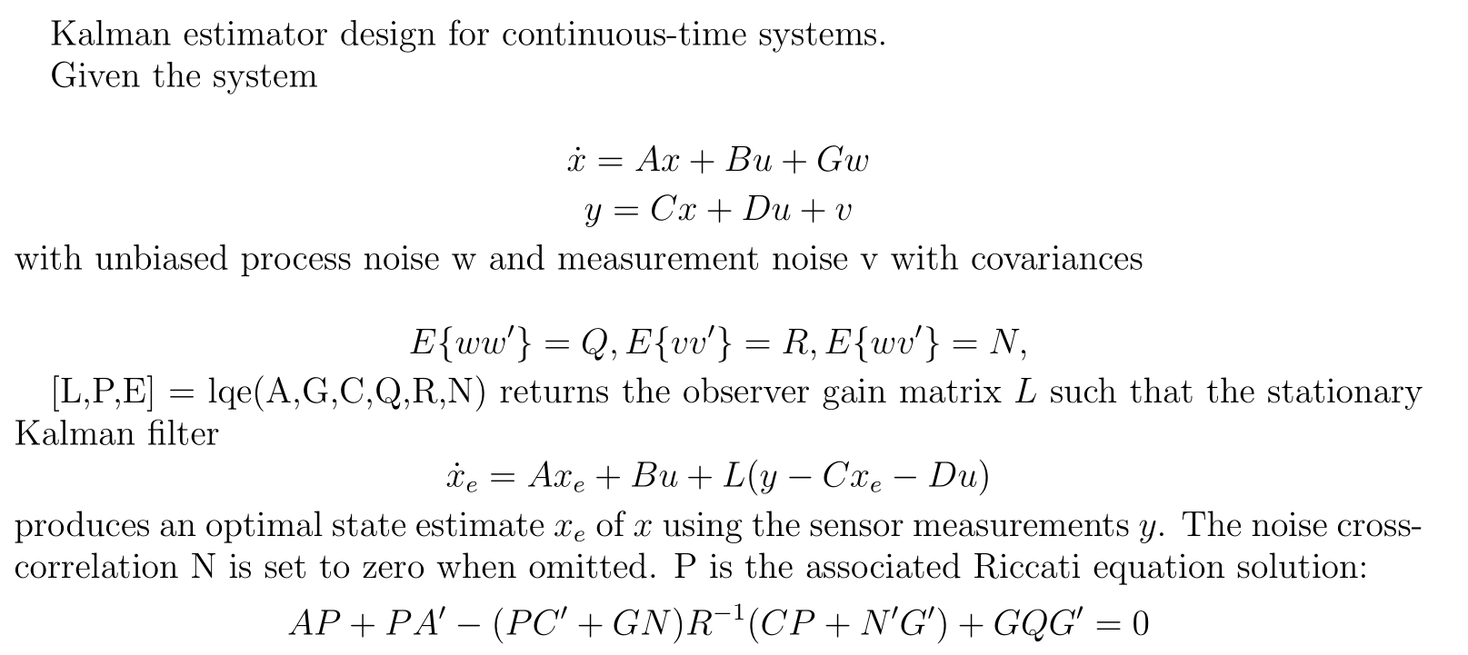
Steady-State Kalman-Bucy Filter (Wiener)

